Slide 1
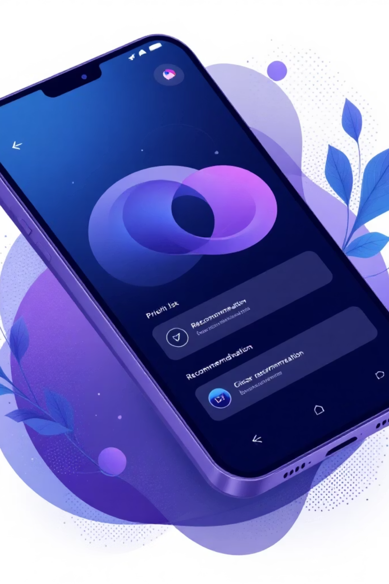
Smart Task Manager
A Project Explanation Document
-By P. Thanmai

Slide 2

The Core Problem
Traditional task apps often fail to help users prioritize, manage cognitive load, or guide them to the next actionable step.
Cognitive Overload
Lack of Prioritization
No Actionable Steps
Users struggle with too many choices and lack clear direction.
Difficulty in identifying the most important tasks to tackle first.
Apps don't guide users toward immediate, executable actions.

Slide 3
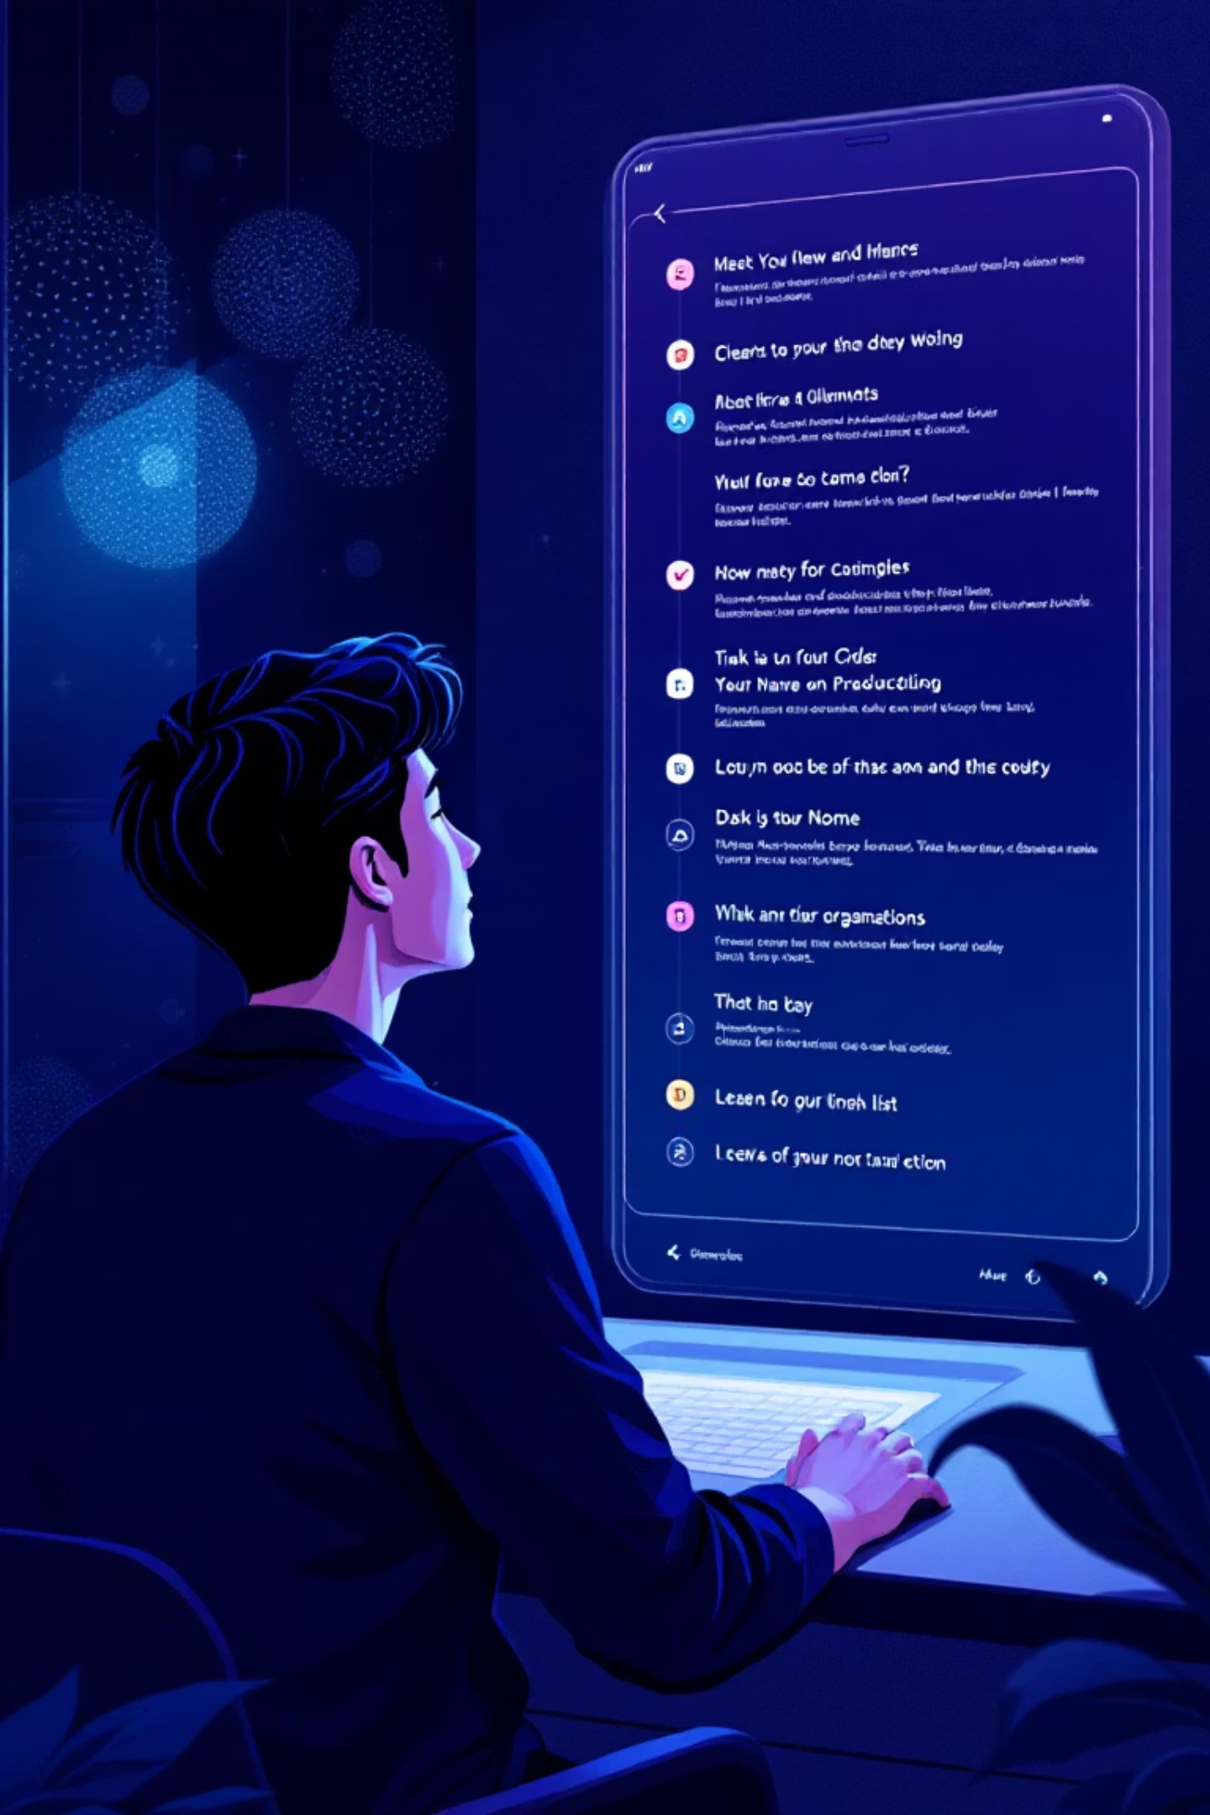
Our Solution: Intelligent Task Management
Designed to reduce overwhelm and increase execution by guiding users toward the next best task.

Slide 4

Target Users & Their Needs
Primary Users
Students & early professionals juggling deadlines, misjudged effort, and overwhelm.
What should I do next?
Workload Clarity
Reduced Decision Fatigue
Simple UI

Slide 5
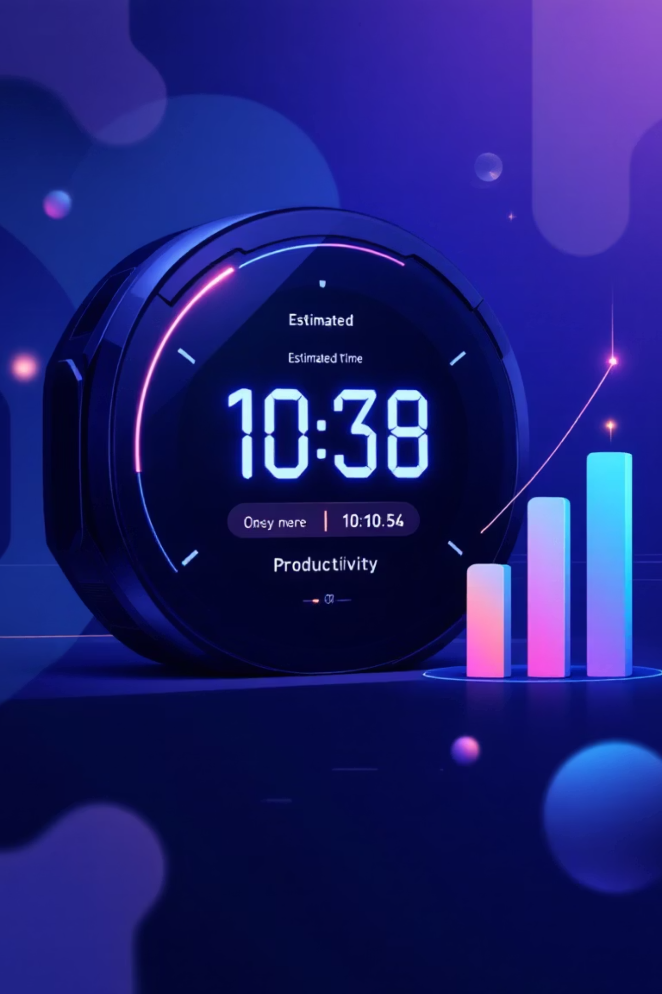
Key Features
Smart Recommendation Engine
Picks the best next task based on due date, effort, priority, and creation time.
Focus Mode
Eliminates cognitive overload by showing one task at a time.
Effort-Based Planning
Categorizes tasks by 2 min, 5 min, 15 min, or Deep Work.
Estimated Completion Time (ECT)
Provides realistic workload time estimates.

Slide 6
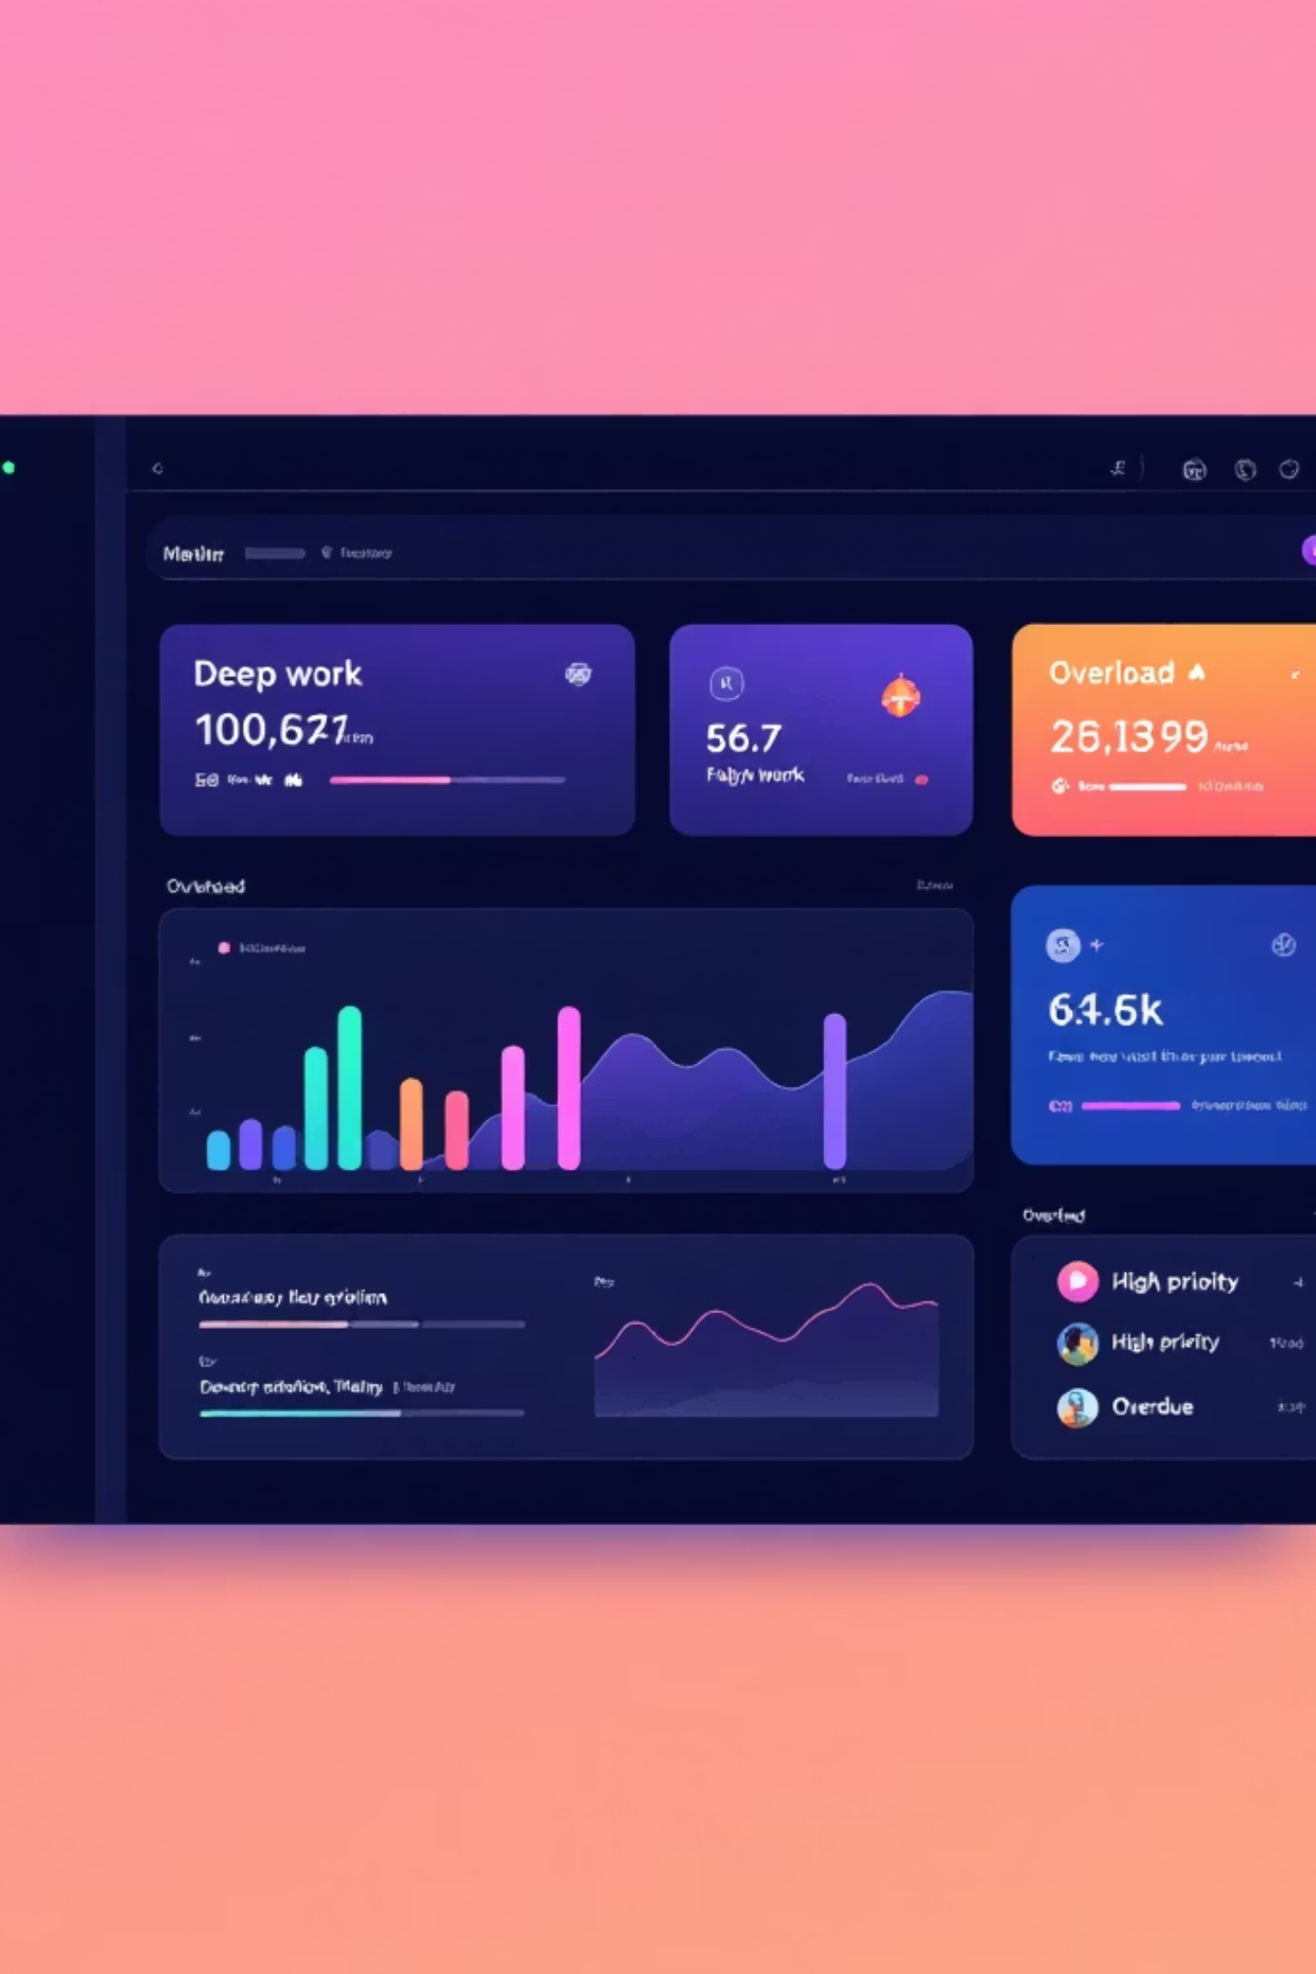
Motivation & Warnings
Progress Indicator
Color-based motivation: red → blue → green.
Overload Warnings
Alerts for too many deep work, high-priority, or overdue tasks.

Slide 7




Design Principles
Cognitive Simplicity
Progressive Disclosure
Only show what matters to reduce mental strain.
Collapse long text until needed, revealing details on demand.
Mobile-Friendly
Performance
Responsive layouts ensuring usability across all devices.
Pure HTML/CSS/JS for instant loading and responsiveness.

Slide 8
Prioritization & Technical Decisions
Prioritization
1
Must-haves
Technical Stack
CRUD tasks, filters, progress, recommendation engine, focus mode.
HTML + CSS + JavaScript + LocalStorage
2
Should-haves
Chosen for fast iteration, lightweight design, and full UI control.
ECT, warnings, custom dropdowns.
3
Could-haves
Login, reminders, calendar view.

Slide 9






Future Improvements
Login + Cloud Sync
Calendar View
AI Task Breakdown
Gamification
Cross-device Sync

Slide 10

Smart Task Manager: A Decision Assistant
More than just a task list, it intelligently guides users, manages cognitive load, and helps them execute tasks with clarity and focus.

